Slide 1


RESOURCE_Printing Methods

Slide 2
Printing Methods
There are six main methods of printing on fabric.
🔹 Block Printing
🔹 Roller Printing
🔹 Screen Printing
🔹 Heat Transfer
🔹 Digital Printing
🔹 Dye Sublimation
Virtu Design Institute Pty Ltd (RTO 40530 - ABN 31 154 273 757) trading as APC Design School
Young Rabbit Pty Ltd (ABN 28 003 381 182) trading as Australian Pacific College | RTO Code: 90396 | CRICOS Provider Code: 01331F

Slide 3
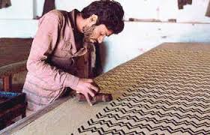
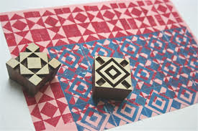
Block Printing
Block printing is a slow, laborious process and is therefore not suitable for high volume commercial use.
Woodblock printing is a technique for printing text, images or patterns used widely throughout East Asia and originating in China as a method of printing on textiles and later paper.
The blocks are usually made of wood and the design is hand carved, so that it stands out in relief against the background surface.
The print paste is applied to the design surface on the block and the block then pressed against the fabric.
The process is repeated with different designs and colours until the pattern is complete.
Textile Learner
Virtu Design Institute Pty Ltd (RTO 40530 - ABN 31 154 273 757) trading as APC Design School
Young Rabbit Pty Ltd (ABN 28 003 381 182) trading as Australian Pacific College | RTO Code: 90396 | CRICOS Provider Code: 01331F

Slide 4
Roller Printing
Roller printing, also called cylinder printing or machine printing, on fabrics is a textile printing process patented by Thomas Bell of Scotland in 1783.
This method was used to produce cotton dress fabrics from the 1790s, most often reproducing small monochrome patterns.
Improvements in the technology resulted in more elaborate roller prints in bright, rich colours from the 1820’s.
Today, up to a dozen different colours can be printed simultaneously.
Virtu Design Institute Pty Ltd (RTO 40530 - ABN 31 154 273 757) trading as APC Design School
Young Rabbit Pty Ltd (ABN 28 003 381 182) trading as Australian Pacific College | RTO Code: 90396 | CRICOS Provider Code: 01331F

Slide 5

Roller (rotary) Printing onto Fabric
https://www.youtube.com/watch?v=F9DSD96_9-4
Virtu Design Institute Pty Ltd (RTO 40530 - ABN 31 154 273 757) trading as APC Design School
Young Rabbit Pty Ltd (ABN 28 003 381 182) trading as Australian Pacific College | RTO Code: 90396 | CRICOS Provider Code: 01331F

Slide 6
Screen Printing
A form of stenciling
The screen is made from mesh, which is stretched over a frame.
Screen in prepared by using an emulsion to “block out” parts of the screen and leave areas of mesh where ink will be placed to create the desired design.
The ink/paint/dye is then placed at one end of the screen and dragged across the mesh with a squeegee
Each colour in the design must be represented by a different screen.
The development of rotary screen-printing machines means that very high rates of production are possible using this once quite slow printing process.
Virtu Design Institute Pty Ltd (RTO 40530 - ABN 31 154 273 757) trading as APC Design School
Young Rabbit Pty Ltd (ABN 28 003 381 182) trading as Australian Pacific College | RTO Code: 90396 | CRICOS Provider Code: 01331F

Slide 7
Screen Printing at Home
https://www.youtube.com/watch?v=RSpsWewtxXw
Virtu Design Institute Pty Ltd (RTO 40530 - ABN 31 154 273 757) trading as APC Design School
Young Rabbit Pty Ltd (ABN 28 003 381 182) trading as Australian Pacific College | RTO Code: 90396 | CRICOS Provider Code: 01331F

Slide 8
Heat Transfer Printing
Transfer printing is the term used to describe textile and related printing processes in which the design is first printed on to a flexible non-textile substrate and later transferred by a separate process to a textile.
Transfer printing is easy to do at home with store bought transfer paper, a home printer and an iron.
Remember, you must print your image in reverse onto the paper first, particularly if it includes any text.
Read more at TEXTILE LEARNER
Virtu Design Institute Pty Ltd (RTO 40530 - ABN 31 154 273 757) trading as APC Design School
Young Rabbit Pty Ltd (ABN 28 003 381 182) trading as Australian Pacific College | RTO Code: 90396 | CRICOS Provider Code: 01331F

Slide 9
Heat Transfer Printing
https://www.youtube.com/watch?v=E03uER3gdHY
Virtu Design Institute Pty Ltd (RTO 40530 - ABN 31 154 273 757) trading as APC Design School
Young Rabbit Pty Ltd (ABN 28 003 381 182) trading as Australian Pacific College | RTO Code: 90396 | CRICOS Provider Code: 01331F

Slide 10
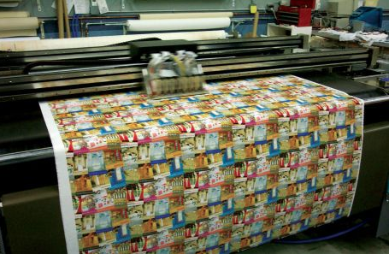

Digital Printing
Fabric inkjet printers print with dyes, very much like an inkjet printer at home would print on a piece of paper.
Digital printing can refer to placement prints or to prints on a roll of fabric – as image
Digital printing is usually restricted to a synthetic fibre content of at least 80%
Benefits include: Bright colours, minimal waste of fabric and ink/dye.
Virtu Design Institute Pty Ltd (RTO 40530 - ABN 31 154 273 757) trading as APC Design School
Young Rabbit Pty Ltd (ABN 28 003 381 182) trading as Australian Pacific College | RTO Code: 90396 | CRICOS Provider Code: 01331F

Slide 11
Digital Printing
https://www.youtube.com/watch?v=sOhW0fDkjDU
Virtu Design Institute Pty Ltd (RTO 40530 - ABN 31 154 273 757) trading as APC Design School
Young Rabbit Pty Ltd (ABN 28 003 381 182) trading as Australian Pacific College | RTO Code: 90396 | CRICOS Provider Code: 01331F

Slide 12
Sublimation Printing
Dye-sublimation printing is a computer printing technique which uses heat to transfer dye onto materials such as a plastic, card, paper, or fabric.
Uses heat of 180 – 210 degrees Celsius to transfer dye onto fabric.
Under high temperature and pressure, the dye turns into a gas and permeates the fabric and then solidifies into its fibers.
The fabric is permanently dyed so it can be washed without damaging the quality of the image.
Virtu Design Institute Pty Ltd (RTO 40530 - ABN 31 154 273 757) trading as APC Design School
Young Rabbit Pty Ltd (ABN 28 003 381 182) trading as Australian Pacific College | RTO Code: 90396 | CRICOS Provider Code: 01331F

Slide 13
Sublimation Printing
https://www.youtube.com/watch?v=hDSV7Mt-Mzo
Virtu Design Institute Pty Ltd (RTO 40530 - ABN 31 154 273 757) trading as APC Design School
Young Rabbit Pty Ltd (ABN 28 003 381 182) trading as Australian Pacific College | RTO Code: 90396 | CRICOS Provider Code: 01331F

